Slide 1
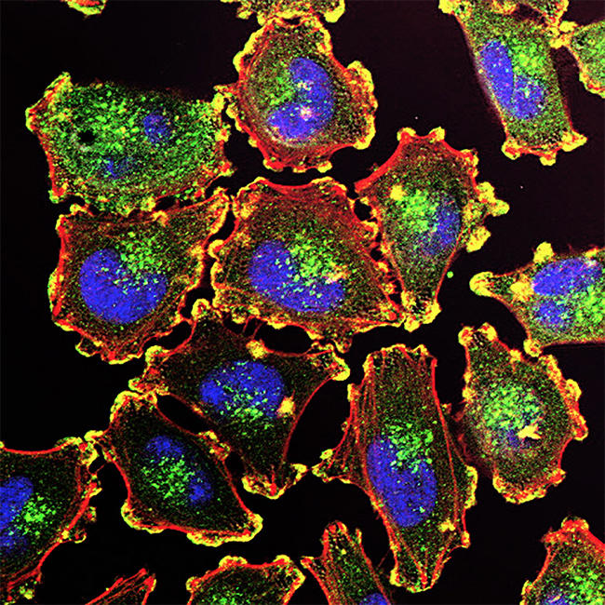
Developing an Automated Diagnostic System for Skin Lesions Using Advanced Machine Learning Techniques
Kinjal Sakhida, BLS/LLB
Meenakshi Tiwary Kleiman, PhD
September 19, 2024
National Cancer Institute

Slide 2
HAM10000 dataset
The HAM10000 dataset: 10,015 dermatoscopic images collected over 20 years from the Medical University of Vienna, Austria, and a skin cancer practice in Queensland, Australia.
https://www.kaggle.com/datasets/kmader/skin-cancer-mnist-ham10000
AKIEC (Actinic Keratoses & Bowen's Disease): Precancerous, scaly patches from sun exposure. Can progress to squamous cell carcinoma if untreated.
BCC (Basal Cell Carcinoma): Most common skin cancer. Slow-growing, rarely metastasizes, appears as shiny bumps or nodules on sun-exposed areas.
BKL (Benign Keratosis-like Lesions): Includes harmless growths like solar lentigines (age spots), seborrheic keratoses, and lichen-planus-like keratoses.
DF (Dermatofibroma): Small, benign, firm nodules, often found on the lower legs, typically due to skin injury.
MEL (Melanoma): Aggressive skin cancer. Early detection is crucial as it can rapidly metastasize.
NV (Melanocytic Nevi): Common moles, benign growths of melanocytes. Most are harmless, but some may evolve into melanoma.
VC (Vascular Lesions): Includes angiomas (benign blood vessel growths), angiokeratomas, pyogenic granulomas, and hemorrhages.

Slide 3
Project Objectives
Gender-Based Analysis:
Determine the prevalence and distribution of different skin lesion types across genders.
Lesion Frequency by Gender:
Explore how frequently various lesion types occur relative to gender.
Demographic Localization:
Study the localization of skin lesions concerning sex and age demographics.
Automated Diagnostic System:
Develop an automated diagnostic system using various machine learning techniques—both unsupervised and supervised (Convolutional Neural Networks).
Aim for a diagnostic accuracy exceeding 75%.
Interactive Dashboard Development:
Create a user-friendly dashboard utilizing JavaScript and Chart.js to display findings and analytics dynamically.

Slide 4
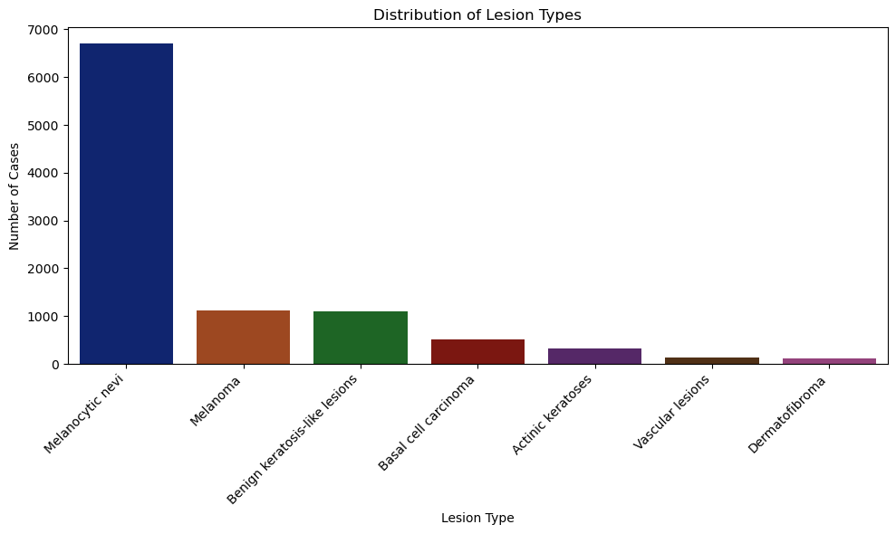
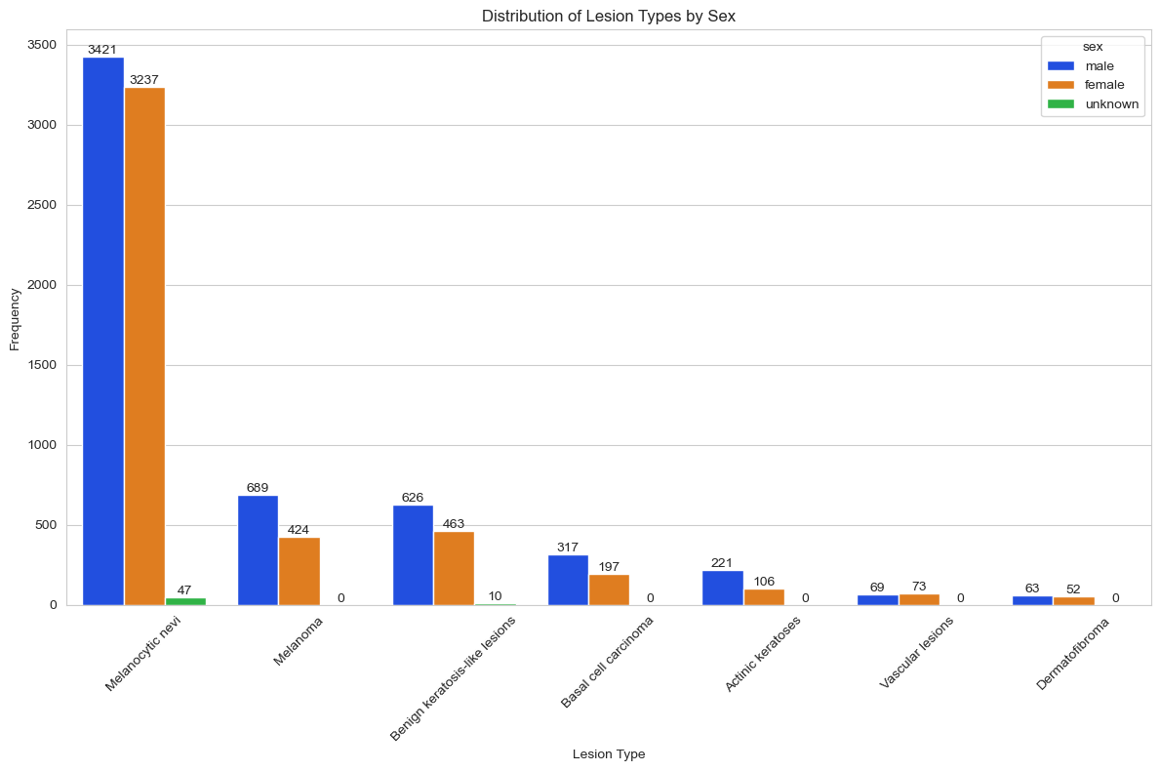
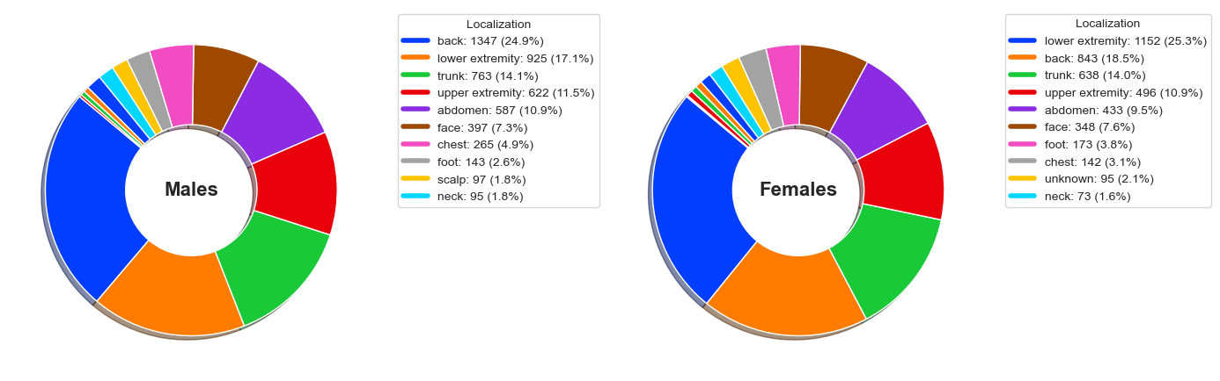
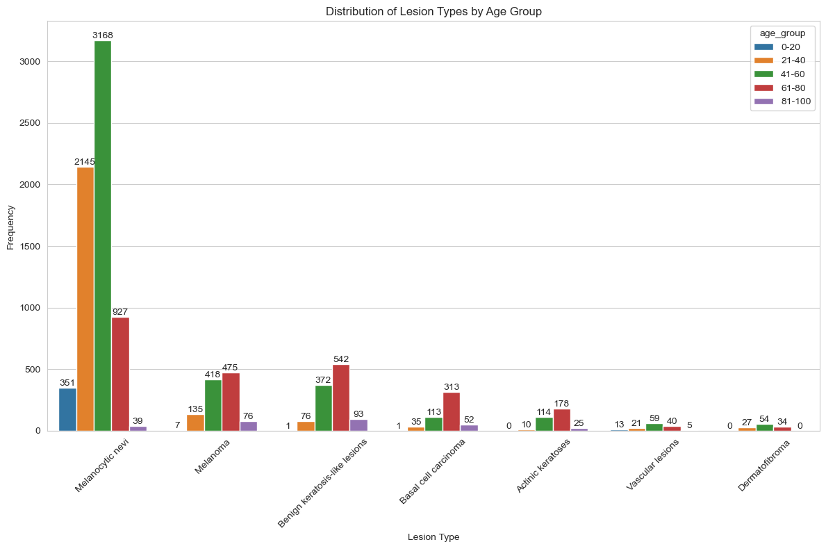
Data distribution and demography

Slide 5
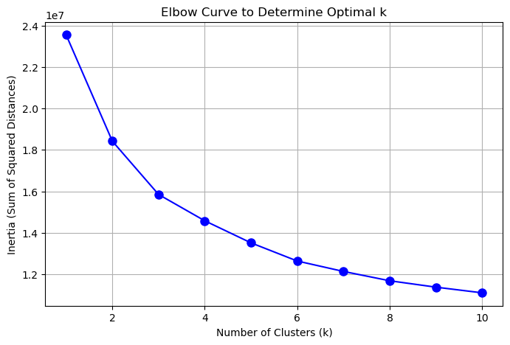
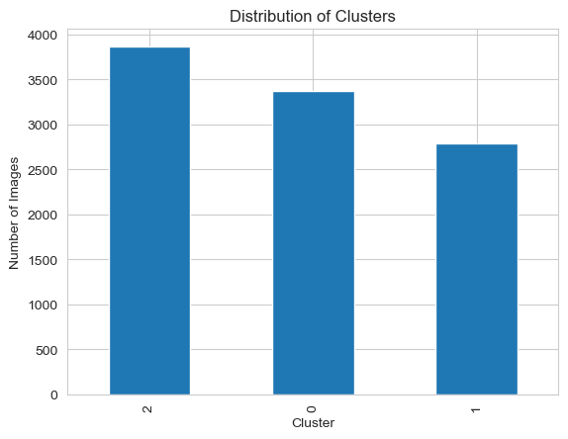
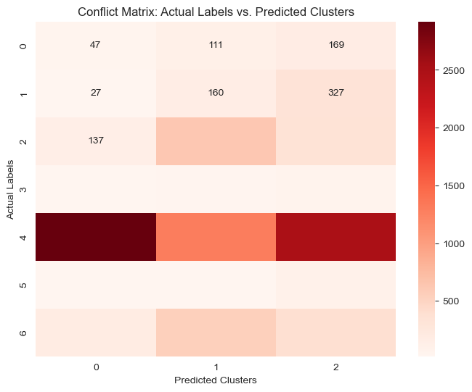
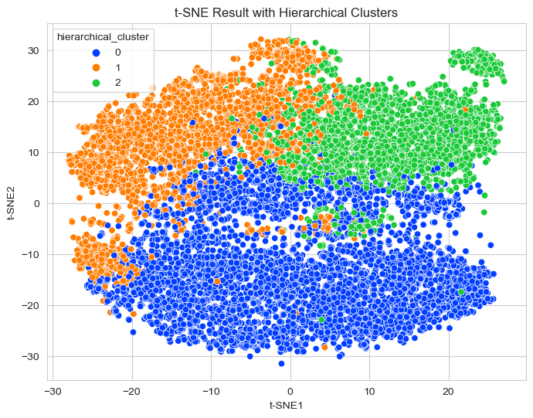
Unsupervised Learning Predicted Three Clusters
Adjusted Rand Index: 0.056

Slide 6
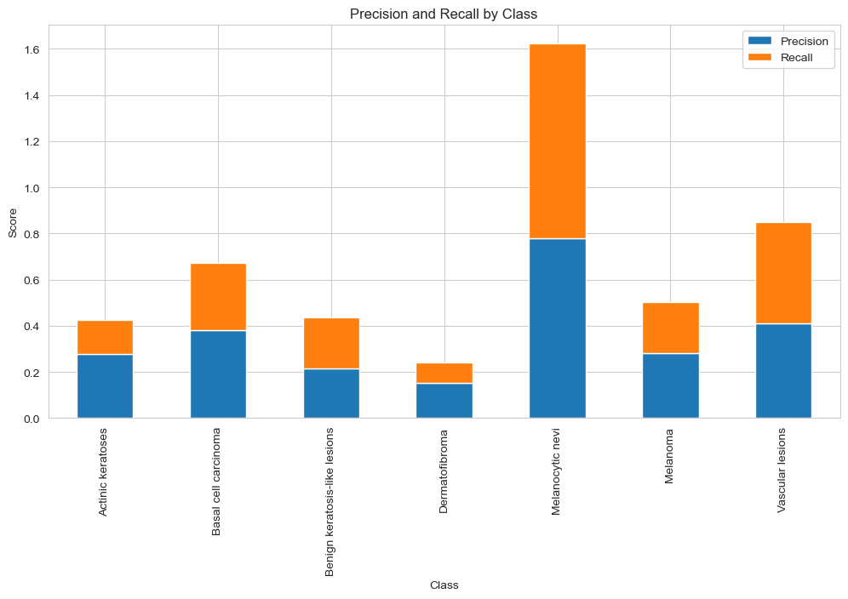
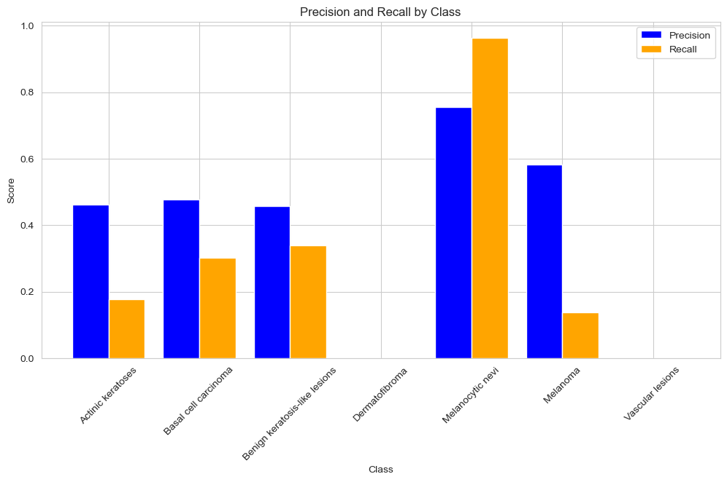
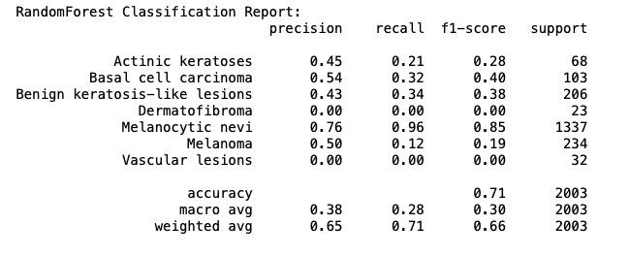
Supervised Learning using Logistic Regression and Random Forest
Logistic regression
Random Forest
Accuracy 68%
Accuracy 72%

Slide 7
Convolutional Neural Network (CNN) For Image Mapping
1
Load the image data
CSV file
2
Separate
Label from image pixel value
3
Reshape
Flattened image back to original shape (28x28x3)
4
5
6
Pixel value from [0, 255] to [0,1]
Normalize
Dataset into training and testing sets
Split
Convolution layers, pooling layers, and fully connected layers
CNN processing

Slide 8
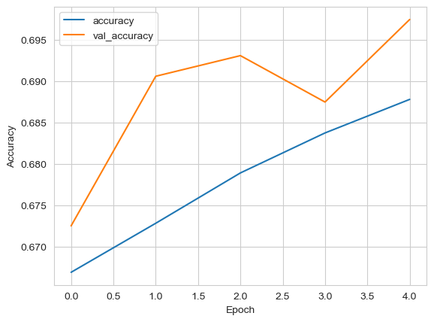
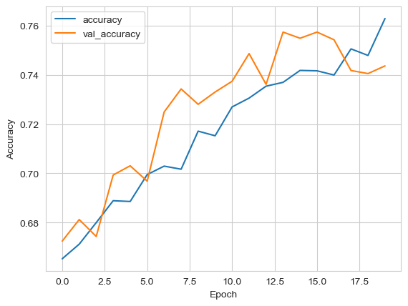
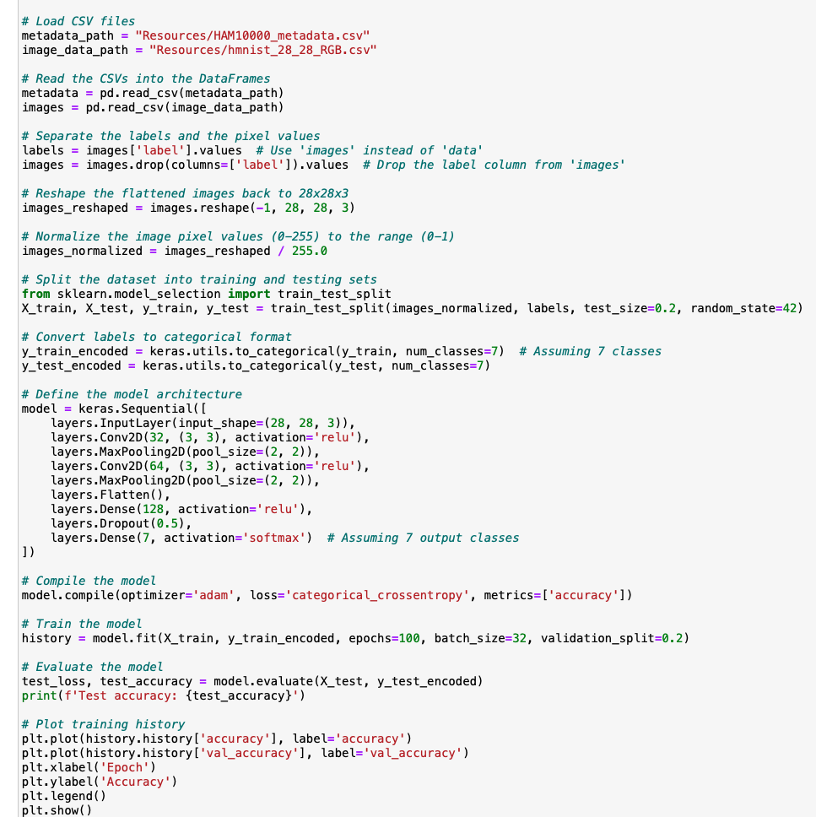
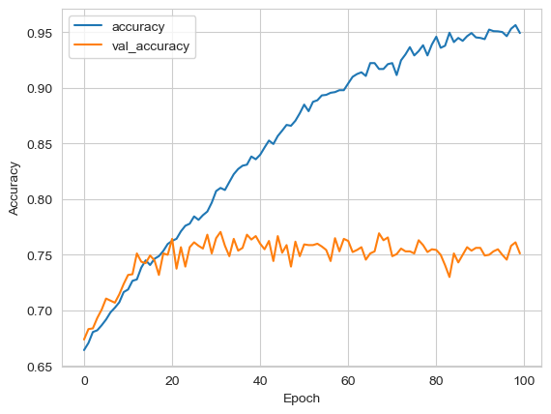
Convolutional Neural Network (CNN) For Image Classification
Epochs = 5, accuracy 0.68
Epochs = 20, accuracy 0.72
Epochs = 100, accuracy 0.76

Slide 9
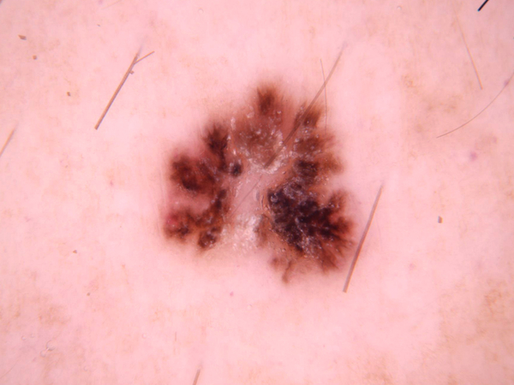
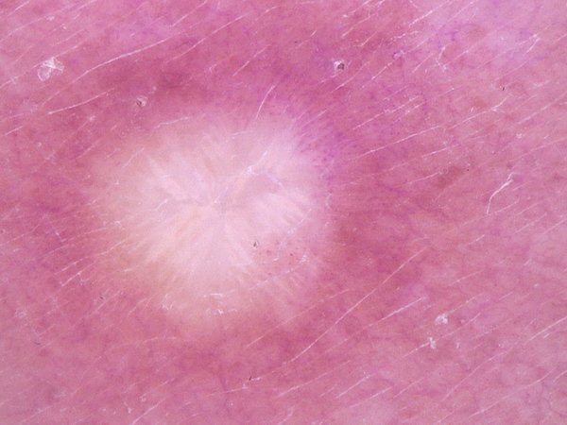
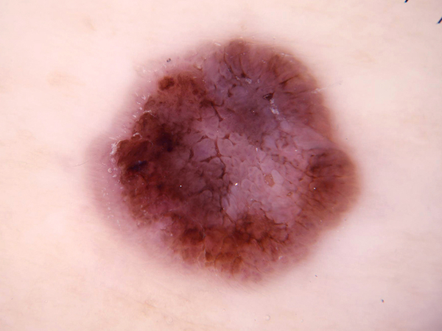
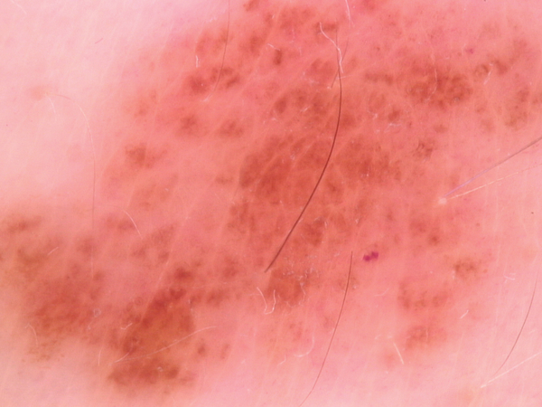
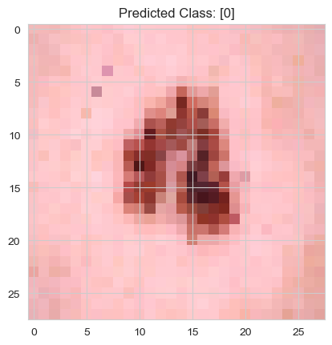
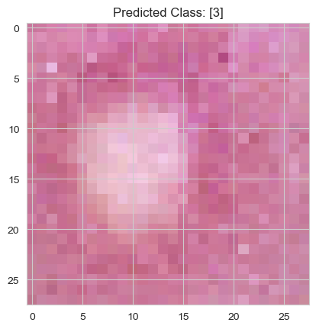
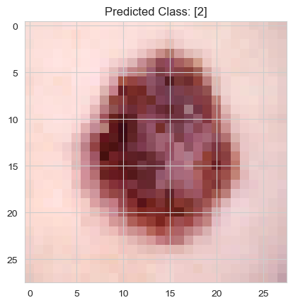
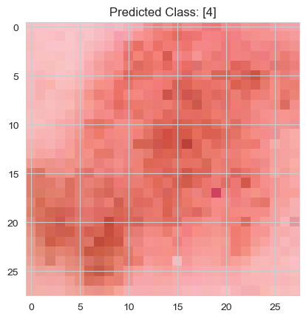
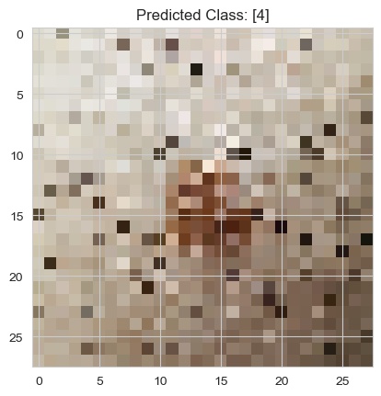
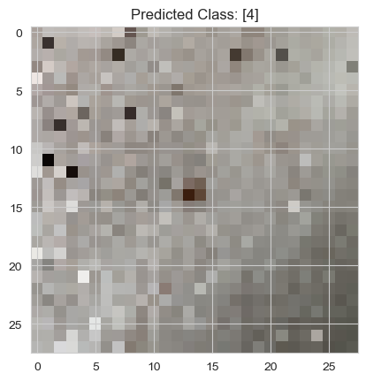
Optimized Model Predicted Correct Lesion Class

Slide 10
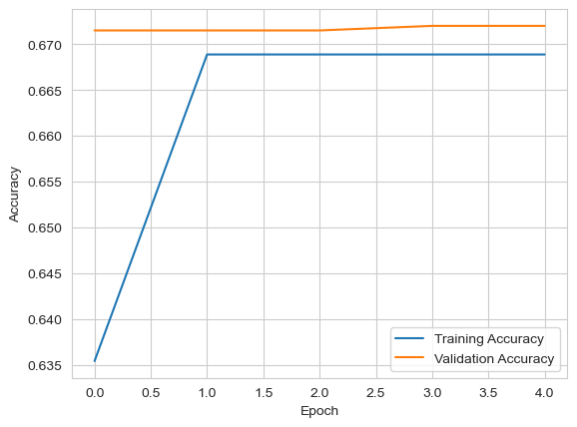
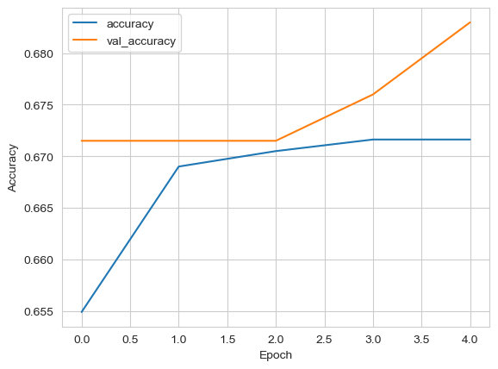
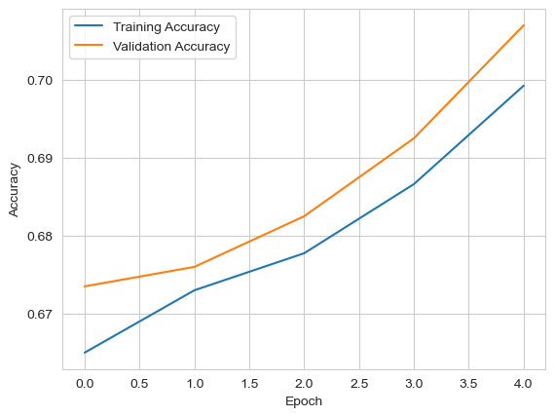
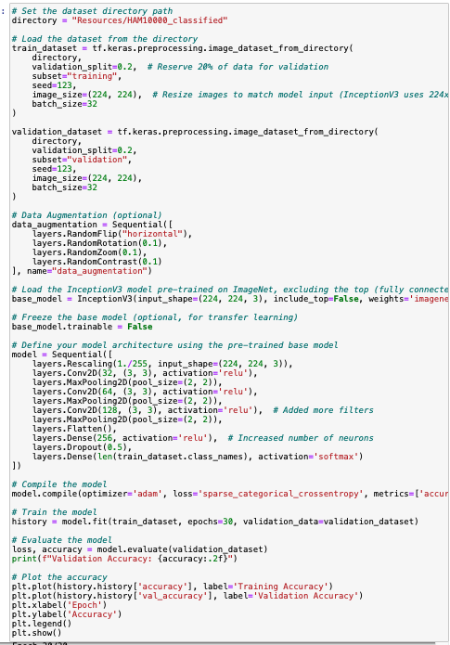
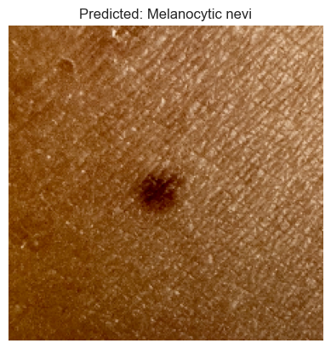
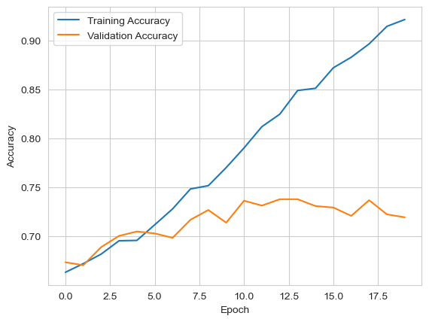
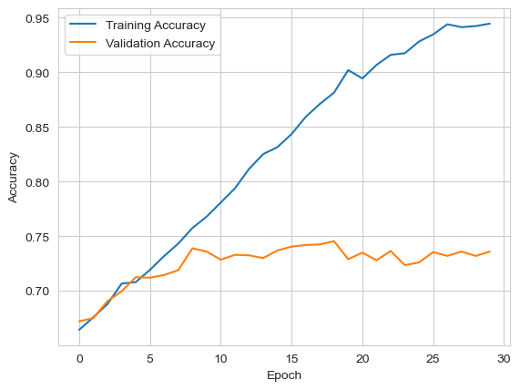
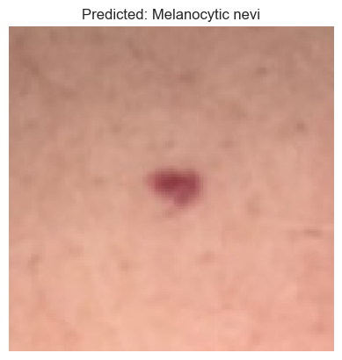
Convolutional Neural Network (CNN) For Image Classification: Using Images
Utilizing Inception V3 model
Data augmentation
Complex model architecture
Accuracy 0.68 %
Accuracy 0.68 %
Accuracy 0.71 %
Epochs = 20, Accuracy 0.71 %
Epochs = 30, Accuracy 0.74 %

Slide 11
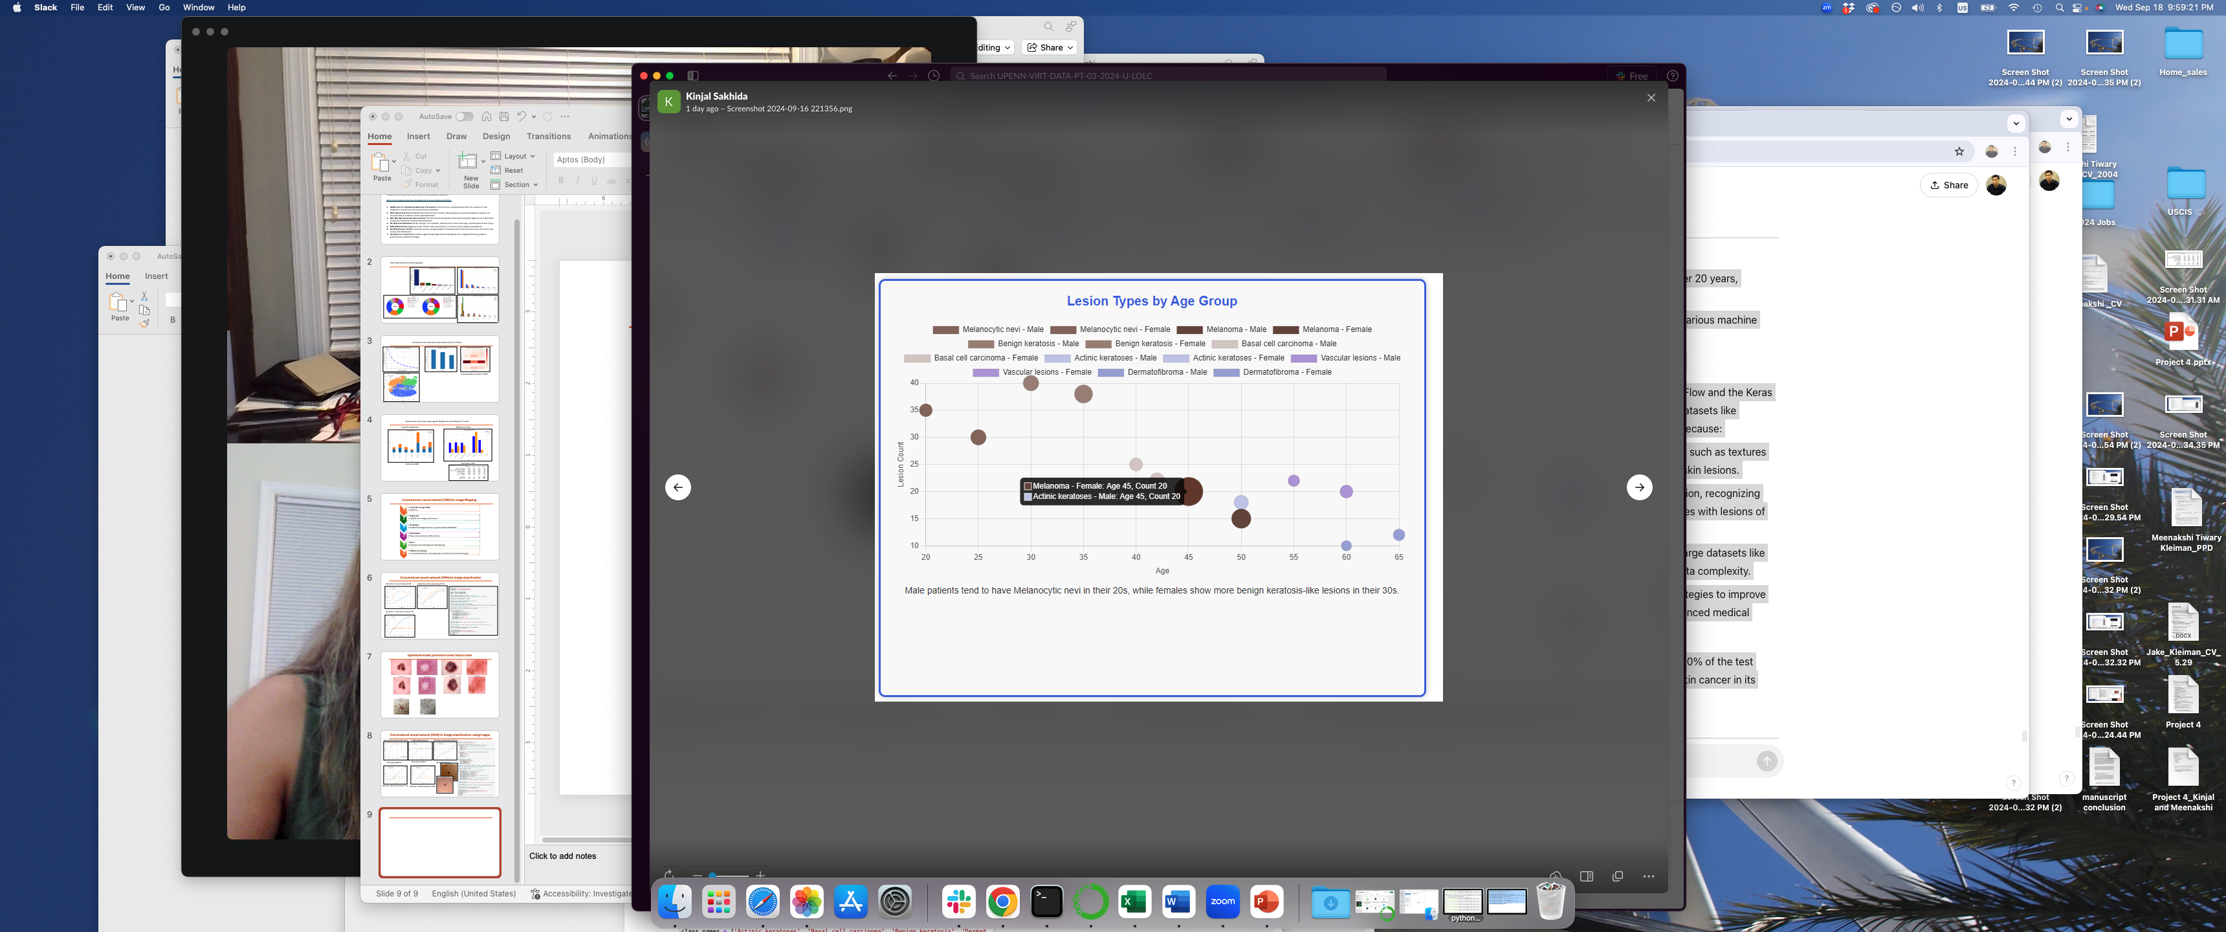
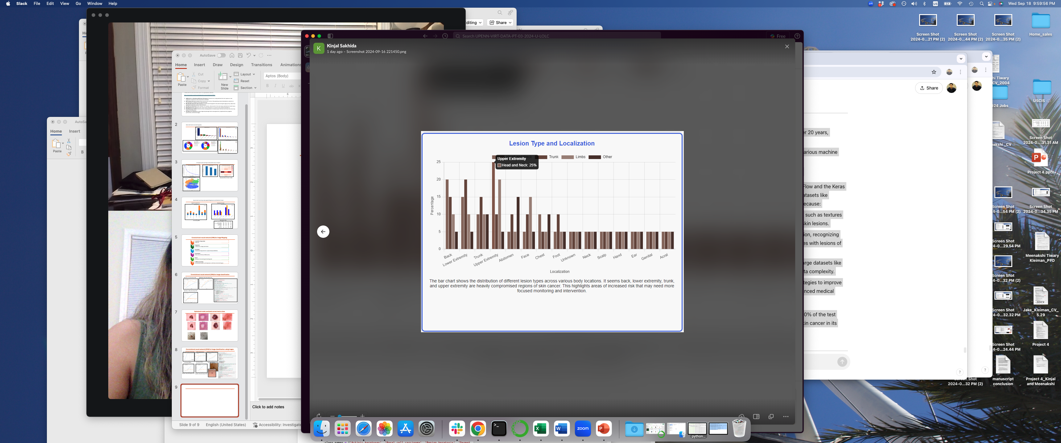
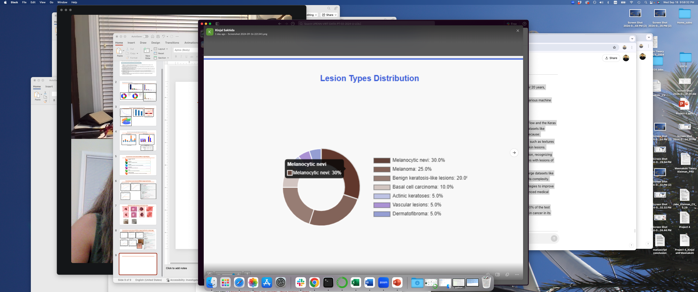
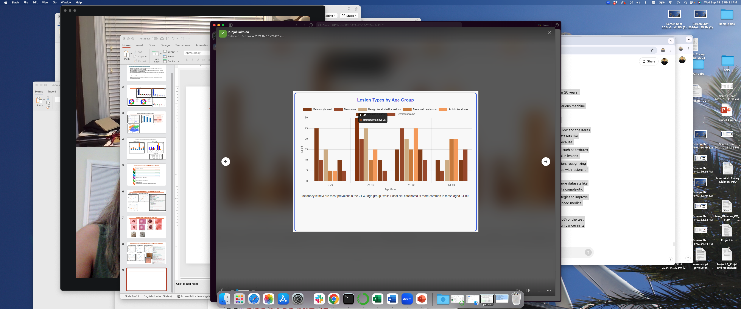
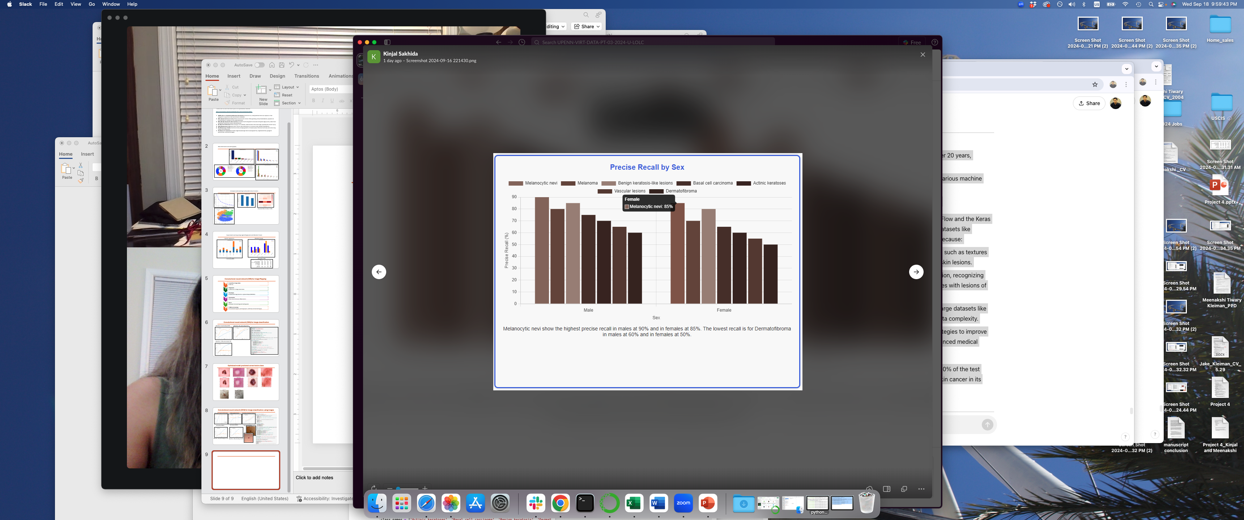
Interactive Dashboard Development

